Slide 1

culture
Dr. Ayushi Jain
Dept Of Community Physiotherapy
MGM Institute Of Physiotherapy
Chh. Sambhajinagar

Slide 2
Introduction
Culture is derived from the English word ‘kulthra’ and Sanskrit word ‘samskar’, which denotes social channel and intellectual excellence. Culture is a way of life.
Culture is an organisation of phenomenon of acts (patterns of behaviour) objects (tools) ideas (belief, knowledge, sentiments) attitudes values the use of symbols.

Slide 3
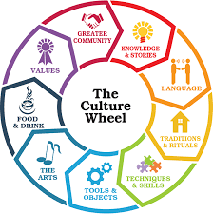
definition
‘Culture is a complex whole, which includes knowledge, belief, art, morals, customs and any other capabilities and habits acquired by the man as a member of society’—EB Taylor

Slide 4

Characteristics
Culture is an acquired quality or learned way of behaviour. It is learned through experience, imitation, communication, concept, thinking and socialisation process.
Culture is transmitted by vertically or horizontally and thus it is communicative. Vertical transmission is from generation to generation, horizontal transmission is from one group to another group within the same period.
Culture is social but not individual.
Culture is idealistic, adoptive, integrative.
Culture fulfills some needs and desires of individual to fulfill group functions.

Slide 5
Culture evolves into more complex forms through division of labour, which develops special skills, the interdependence of members within the society.
Culture is continuous and cumulative.
Culture is dynamic. Culture is subjected to slow but constant changes.
Culture is gratifying. Culture provides opportunities and provides means for the satisfaction of our needs (biological and social) and desires.
Culture varies from society to society.
Culture is super organic. Culture is independent of physical and physiological properties and characteristics.

Slide 6

Types of Culture
Material culture
Non- material culture

Slide 7
Functions of Culture
Culture makes man as a social being.
To regulate the conduct and prepares the human being for group life through the process of socialisation.
It defines the meaning of situation.
Provides solutions to complicated situations as it provides traditional interpretation to certain situations.
Defines values, attitudes and goals.
Broaden the vision of individuals.
Provides behaviour pattern and relationship with others.
Keeps the individual behaviour intact.
Creates new needs and interests.
Moulds national character.
Defines myths, legends, supernatural believes

Slide 8

Organisation of culture
Cultural trait
Cultural pattern
Folk ways
Cultural area
mores
Norms
laws

Slide 9
Factors of Cultural Variations
• Historical accidents. Eg: Monogamy, Polygamy.
• Geographical environment.
• Mobility of human beings.
• Inventions, Discoveries—which influence technology, customs, traditions, believes and faith.
• Individual peculiarities.
• Change on modes of production.
• Dominant cultural themes.

Slide 10
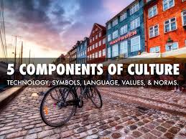
Components of Culture
symbols
language
values
norms
folkways
mores
sanctions
laws
belief

Slide 11
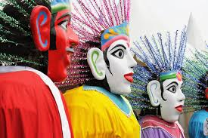

Slide 12
Impact of Culture on Human Behaviour
Human behaviour change from moment to moment, according to the situations. As the culture is the product of human interaction, the human being will be defined and identified by the culture. They will share the values, believes, material objects, ideas, feelings, knowledge, which will transmit from one to another as a social product. Human behaviour is entirely the product of social learning

Slide 13
The impact of culture over the human behaviour will have both positive and negative effects.
Some of the positive effects like:
• Respect each other, love the neighbourhood
• Love all, hurt never
• Share the ideas, thoughts, feelings, and responsibilities with loved ones.
Some of the negative effects:
• Untouchability
• Superiority and inferiority feelings
• Devadasi system.

Slide 14
Culture Induced Symptoms and Diseases
Culture, is the way of living in which the customs, traditions, practices, attitudes, ideas, knowledge will influence individual’s life style. Among these food habits also plays a major role, as a part of culture of a community. Eg: Andhra people consume more spicy food, which may predispose for gastritis.
• Certain community will consume only pure vegetarian food in which they will avoid even onion and garlic, thus leading to nutrition imbalance. Subsequently these people are prone for gastric diseases.
• Other religious consume more of non-vegetarian food, which may lead to obesity, hypertension, and cardiac diseases.
• Pardah system by the women followed by certain community will predispose for vitamin-D deficiency.
• In urban community, due to mechanisation, industrialisation people’s life become monotonous and stress to adjust and accommodate themselves to the changing demands etc., prone for mental illness.

Slide 15
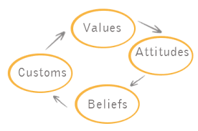

Slide 16
Cultural Factors Affecting Health and Diseases
Customs
Eg: If age—at marriage and age-at gauna is low, may predispose to early pregnancy and will affect mother and child
• Widow remarriages may cause frustration, conflicts and unsoundness in the family
• Polygamy, polygynae, devadasi system, dowry system, alcoholism, drug abuse, will influence the individual’s health

Slide 17
Cultural Factors Affecting Health and Diseases
Beliefs
• Certain religious community does not take any form of medicine or does not utilize the health services as they believe the diseases are due to anger of God, or punishment for their sinful activities, for relief of the illness they will perform pooja, offering prayers, and follow some vaastu principles, due to these believes their health is deteriorating.
• Communicable diseases like mumps, measles, chicken pox are occurring due to the curse of the Goddess and the community will visit temples for the cure of the disease, instead of going to health care members.
• Some cultural factors are positive in nature. If an individual is affected with chickenpox certain practices will be followed like hygienic principles, such as cleanliness, isolation, barrier techniques, giving bath with neem leaves dipped in hot water, giving bland diet for the affected children.

Slide 18
Cultural Factors Affecting Health and Diseases
• The coitus during menstrual periods will result in the prevalence of sexual disorders.
• Hysteria is the result of possession of evil spirit.
• During menstruation certain family will not allow the person to do the family activities and given rest.
• Some elders will not permit the post-natal mother to give colostrum, which is essential for the specific protection for the new born.
• Food restrictions such as eating papaya during first trimester, as it may induce abortion.
• During fairs and festivals, certain practices like, whitewashing the house and all the family members will gather together, share their joys, problems, which will promote the soundness in the family.
• Performing pranayama, meditation and yoga techniques will induce sound mental health.

Slide 19


